Slide 1

Introduction to r Software R
Euclides Mendonça
Euclidesmendonca.f@gmail.com

Slide 2
course Outline
#1 – Introduction to r environment (June 20, 9am – 12 am)
- R e o RStudio
- Command line interface
- Simple manipulations; numbers and vectors
- Objects, their modes and attributes
- Data structures / Lists and data frames
- Functions
- Libraries and Packages
- Reading data from files
- Data assumptions, frequentist tests (cor, t-test, anovas and regression)
# 2: R Graphics and data exploration (June 22, 9am – 12 am)
- Data assumptions, frequentist tests (cor, t-test, anovas and regression)
- Standard graphics in R
- ggplot2: Elegant graphics for data analysis

Slide 3
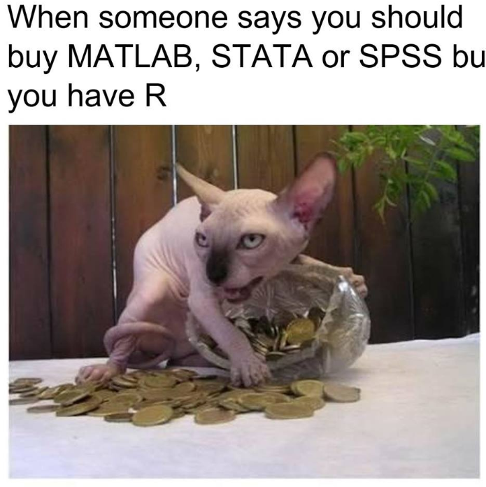
Why use R software?

Slide 4
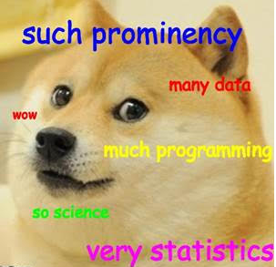
Why use R software?

Slide 5
Why use R software?
It is Free!!!
Has extensive and powerful graphics abilities
The R system is developing rapidly
Simple calculations and analyses can be handled straightforwardly
The R community is widely drawn, from application area specialists as well as statistical specialists.
Concern with reproducibility of studies
Exposed to higher standards of scrutiny than most other systems

Slide 6
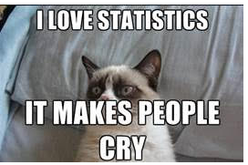
Why use R software? – Down Side
Because R is free, users have no right to expect attention
Be grateful for whatever help is given.
Use of command line interface (but there is a package for click users…)

Slide 7
Why use R software?
R implements a dialect of the S language that was developed at AT&T Bell Laboratories
In 1997 the R Core Group is born - https://cran.r-project.org
2000 R version 1.0.0 launched
2018 version 3.5.0

Slide 8
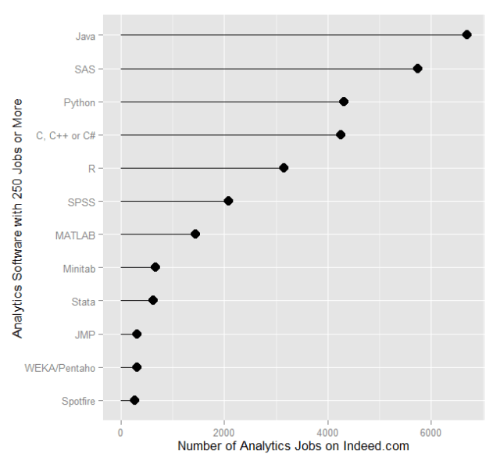
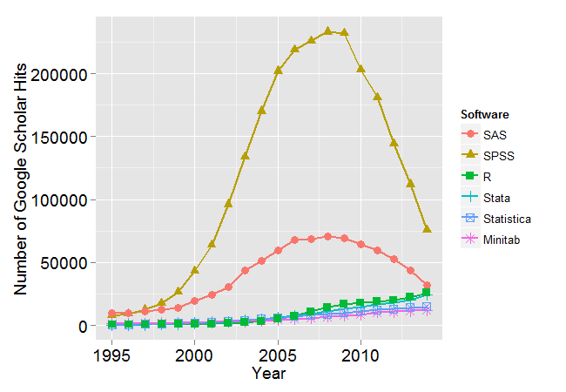
Why use R software?

Slide 9
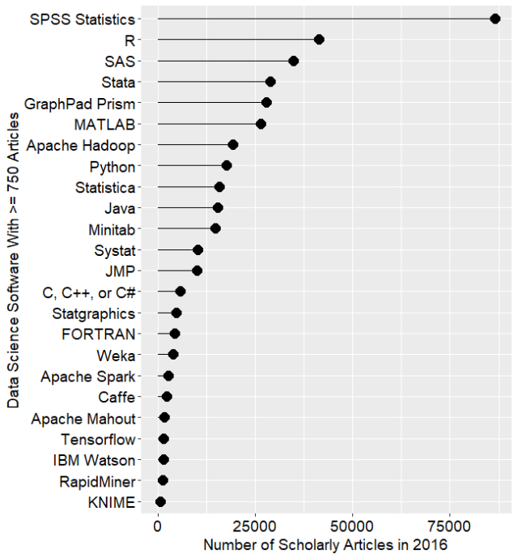
Why use R software?

Slide 10
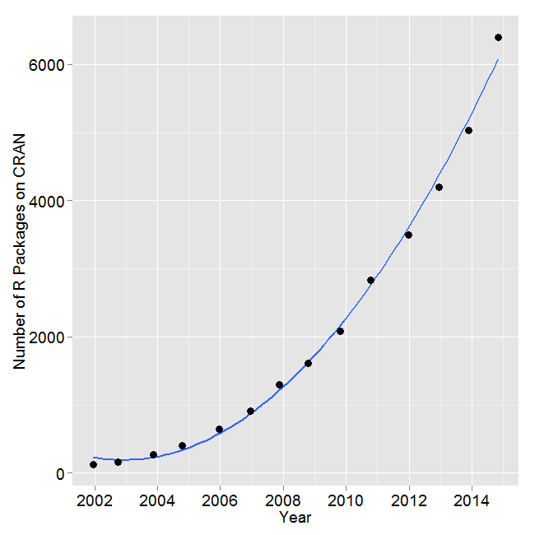
Why use R software?

Slide 11

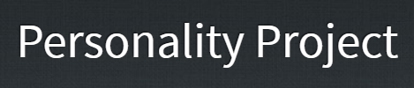






Why use R software?

Slide 12

Getting Started
The basic system - There is a language core that uses standard forms of algebraic notation, allowing the calculations such as 2+3, or 3^11. Beyond this, most computation is handled using functions.
R Studio – More friendly user interface. It allows connexions with other languages, reproducibility, syntaxes and manuscripts edition

Slide 13
R desing
R Design
The “Base” R which can be downloaded from CRAN
All the rest – functions that are programmed from the basic functions
A compilation of written functions is called “packages
In 2015 there was 6000 packages – today we have 12000!

Slide 14
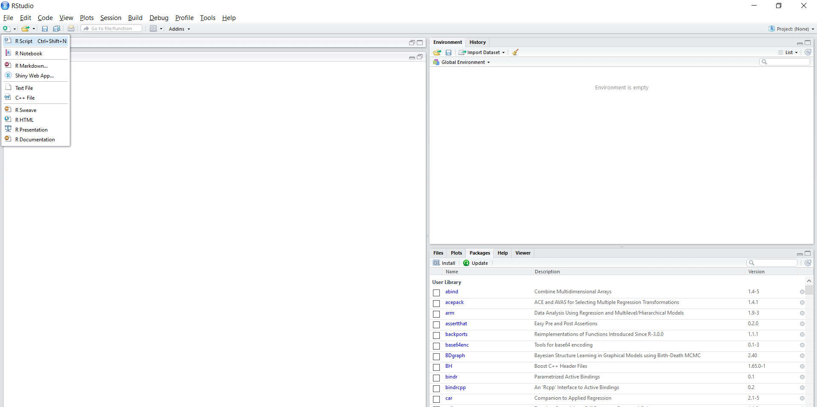
Data sets, variables, models and objects.
History of all commands

Slide 15
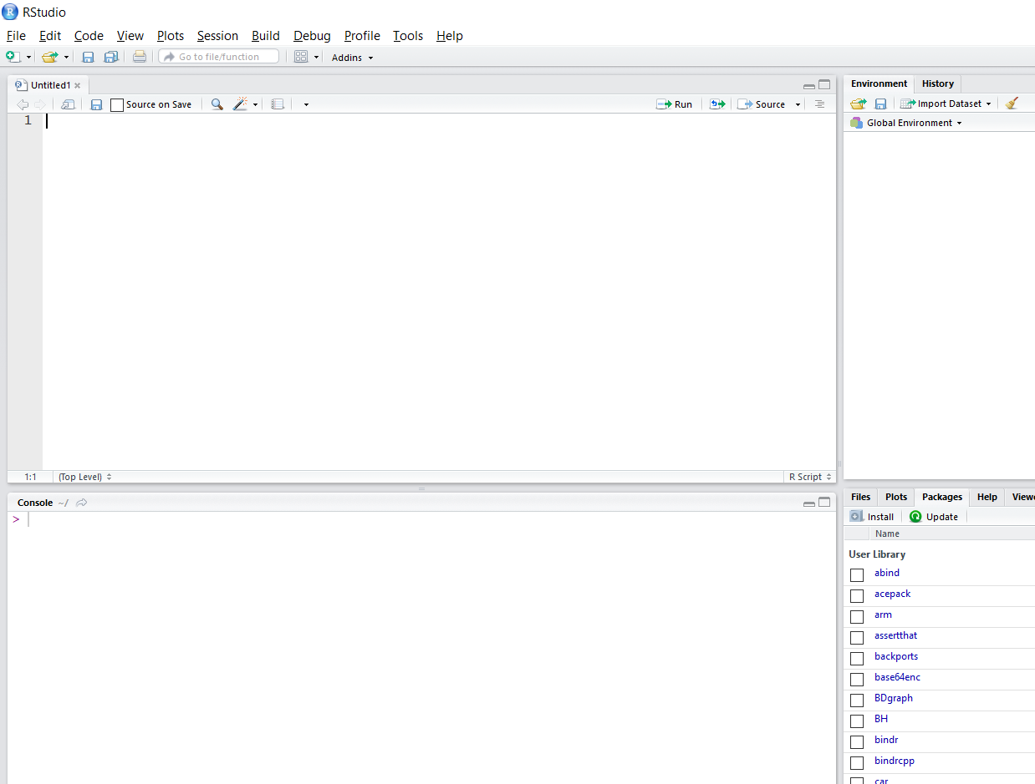
Syntax editor
You can run all your commands here

Slide 16
Syntax editor
You can run all your commands here
The Basic R interface.
Analysis outputs are available here
You can also type commands here

Slide 17
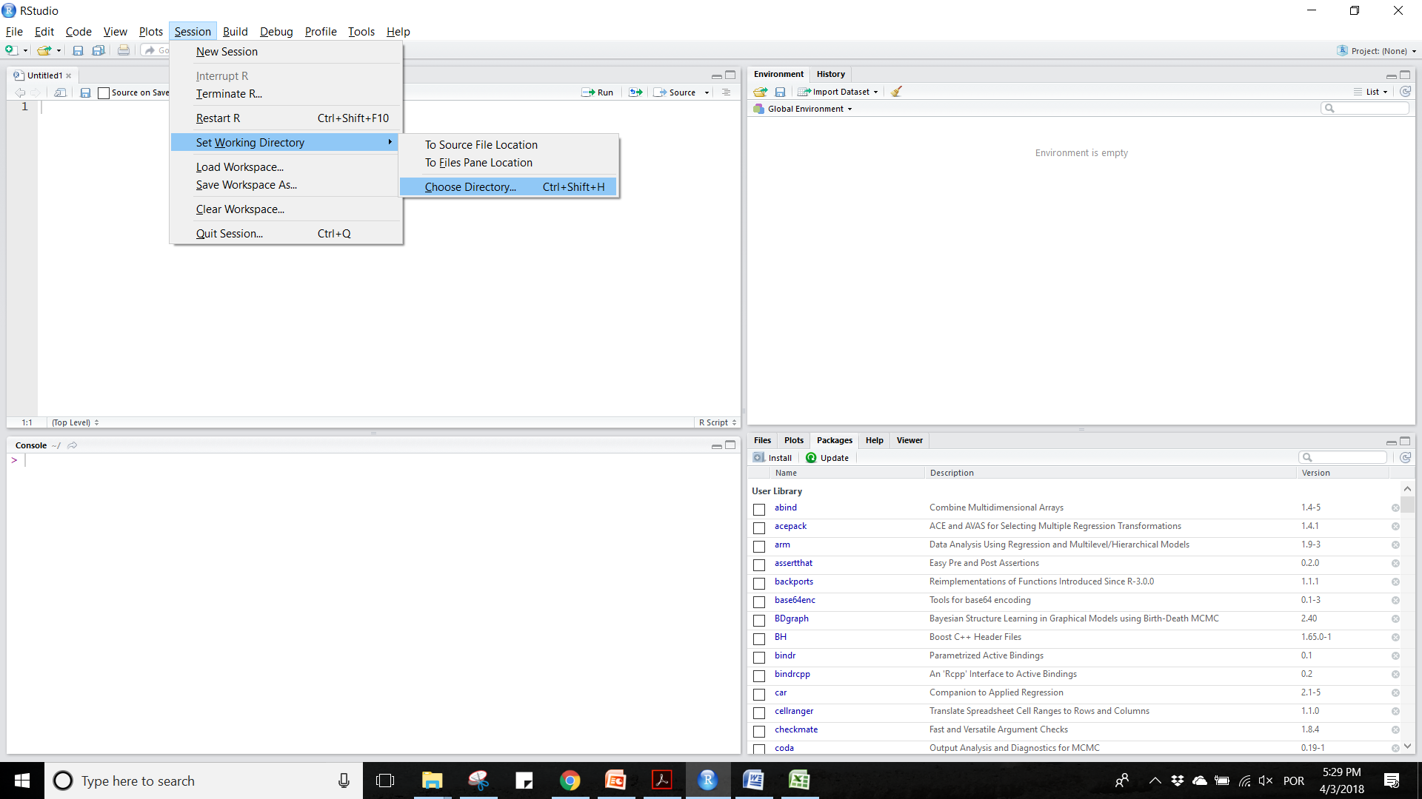
Hot to set your work directory and start a new R session

Slide 18
Hot to set your work directory and start a new R session
Files
Packages
Help
Graphics

Slide 19
#1 – Introduction to r environment (Fec 21 - 9am – 12 am)
- R e o RStudio
- Command line interface
- Simple manipulations; numbers and vectors
- Objects, their modes and attributes
- Data structures / Lists and data frames
- Functions
- Libraries and Packages
- Reading data from files
- Data assumptions, frequentist tests (cor, t-test, anovas and regression)

